Slide 1
Data Protection Notice
The Network for East Anglian Collaborative Outreach (neaco) is a project aimed at increasing the number of young people going into Higher Education. neaco consists of the University of Cambridge (including its Colleges), Anglia Ruskin University, the University of East Anglia, Norwich University of the Arts, and the University of Suffolk.
Take Your Place is the programme which is being run by neaco in schools and colleges in East Anglia. Information about how your personal information will be used by us in connection with the administration of the Take Your Place programme, and for related purposes, is available at https://www.takeyourplace.ac.uk/how-we-use-participant-data.
We will also get in touch by email to facilitate your involvement in the Take Your Place programme. Please contact info@takeyourplace.ac.uk if you have any questions about how we use your data.
takeyourplace.ac.uk

Slide 2
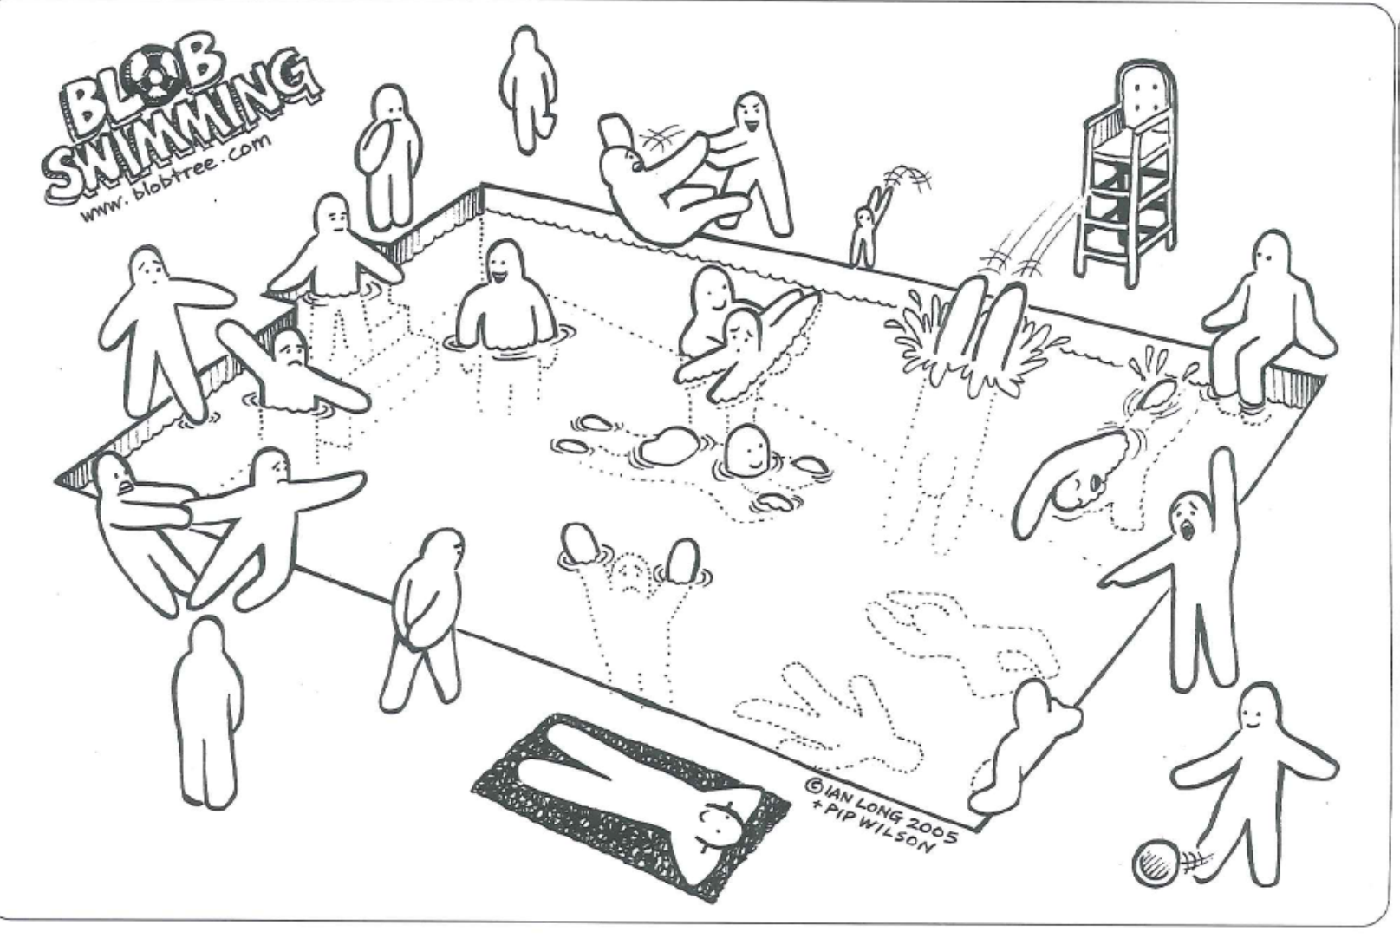
Which blob best reflects how you feel about your next steps?

Slide 3
Completing a Skills Audit
Follow the link on the left to complete a quick personality quiz to help identify potential links between your personality, working styles and careers that might be suited to your skill set. Whatever you do next, into it can be helpful to know your strengths and skills.
icould.com/buzz-quiz/

Slide 4
Which Animal Are You?
The results are based on the Myers-Briggs personality theory developed by Carl Yung
Having taken the personality test, what are identified as potential strengths and areas for development (weaknesses) for your animal type?
Have a look at the other animals, do you agree with your result?
What types of jobs might be suited to your animal type? Think outside those listed on the results page!
Find Out More
Notes:
https://icould.com/buzz-quiz/
ISTJ – Polar Bear
ISFJ – Koala Bear
ISTP – Tiger
ISFP – Cat
INFJ – Sea Horse
INFP – Sea Horse
INTP – Tawny Owl
INTJ – Barn Owl
ESTJ – Black Bear
ESFJ – Teddy Bear
ESTP – Panther
ESFP – Lion
ENFJ – Dolphin
ENFP – Clown Fish
ENTP – Falcon
ENTJ - Eagle

Slide 5
What is the point of the personality test?
Discover potential personality preferences and natural strengths
Identify how we can be the most productive or achieve more
Learn more about the people around us.
What do each of the letters mean?
E or I
S or N
F or T
J or P

Slide 6
Understanding the language
Our flow of energy |  | How we learn information
Extroversion | Introversion | Sensing | Intuition
Stimulated by events and people external to yourself. Show their feelings, learn by talking and work well in a group | Prefer private reflection, self-examination and self discovery. Hide your feelings, often working alone and learn best by watching | Use of senses to engage with the world. Real-life examples and practical activities appeal. Focus on facts but can miss the main idea | Rely on your instincts and work on hunching or having ‘that feeling.’ Driven by imagination and can miss facts when grasping the big picture.
How we make decisions |  | How we interact with the world
Thinking | Feeling | Judging | Perceiving
Use of logical and objective parameters, often asking ‘why.’ Enjoy databases | Use values and subjective ideas. Prefer harmony, agreement and supporting others. | Purposeful, and find an appeal in structure, plans, rules and organisation | Laid=back and relaxed / flexible approach, often more open to changes and are keen to explore.

Slide 7
The BE…DO…HAVE Approach
Who do you want to be?
What do you need to do to achieve this?
What do you want to have (i.e. end goal)?
Notes:
A goal has two faces: the WHAT and the WHO
Face 1 is the WHAT you want to achieve (or HAVE)
Face 2 is the WHO you need to authentically BE to make it happen
The WHO (or the BE) that does the DO is what drives you and subsequently results in the HAVE or WHAT being achieved.
i.e.
First we “be” what we want (peaceful, loving, inspired, abundant, successful, or whatever), then we start “doing” things from this state of being – and soon we discover that what we’re doing winds up bringing us the things we’ve always wanted to “have.”

Slide 8
What future do you envisage?
Expertise
Credentials
This is your niche area
Commitment
Notes:
Expertise – Your skills, your talent, your life experiences
Commitment – What are you passionate about? What drives you?
Credentials – Why are you the go to person?

Slide 9
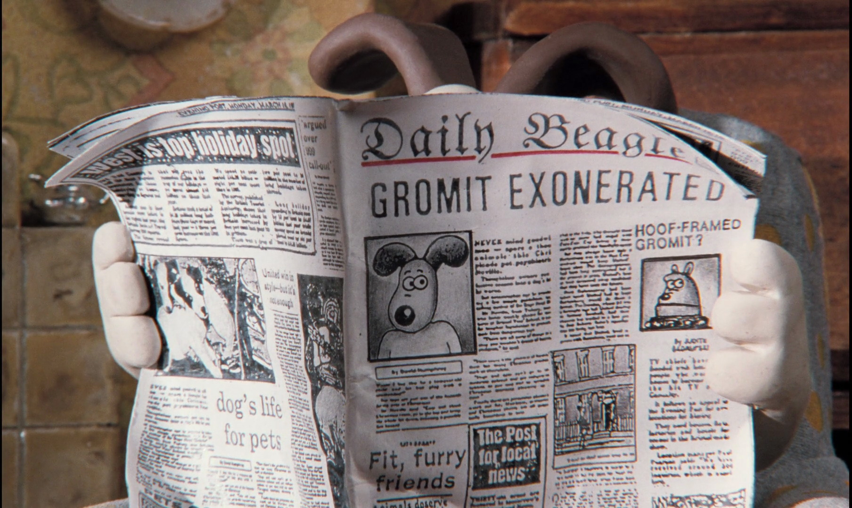
Reflect ‘n’ Sketch Your Legacy
Your editor has asked you to write a short piece (blog post or journal/newspaper article) looking back on your journey; the focus can be academic, career, personal life or a combination of all three.
Your aim is to give the reader a snapshot of the route you chose and decisions you made along the way.
You have 20minutes and a maximum of 500 words to create your first draft. Illustrations are optionaln of all three.
Notes:
Students are given 15 minutes to complete their article. If timings work give students 10 minute break and then ask to feedback

Slide 10
Who is ‘brand-you’?
Skills and Strengths
Values and Attitudes
“You can be anything you want to be if….”
Experiences
Hobbies and Interests
Notes:
Give students 10-15 minutes to work through each question
What buzz words came up for your animal?
What are you good at?
What is important to you?
What do you enjoy?
What interesting things have you done?
What advice would you give?

Slide 11
How do you create your personal brand?
Where do you want to be going forwards?
How do you want to be perceived by others?
How did you get here?
What value can you offer?
What do you stand for or believe in?
How do you want to be remembered?

Slide 12
Creating an Elevator Pitch
Can you identify what you want the audience to remember most about you?
Who are you?
Brief background about what you do. Remember that you may need to add extra context depending on the audience.
Make a connection with the audience. Why do you want them to listen to you? Do you have a USP?
Ask with clarity and close out with a strong final sentence.
Before you start, remember to identify the goal of your Elevator Pitch
Notes:
Brief Background – if you’re not sure what to include write down everything that comes to mind and highlight the points that stand out. Can you organise them into a story?
Connection – Networking, Looking for a job, asking for a mentor, Answering the ‘Tell me about yourself’ interview question,
Remind students not to throw notes away as these might be needed in future sessions.

Slide 13
What Information Goes Into a CV?
Personal Information
Profile Section
Education
Employment History / WEX
Additional Qualifications / Skills
Notes:
No such thing as a perfect CV – Everyone is different; Every role applied for is different
Decisions often made within the first 30seconds of seeing the CV
Clear and easy to follow
Key information should stand out – use formatting to your advantage
Different types of CV: Traditional, Skills Based, Technical, Creative, Academic

Slide 14
Profile or Skills Section
Short and to the point
Who are you?
What are your ambitions?
What transferable / soft skills do you have?
What can you offer to the employer?
Bold key skills
First impression
Education and Extra-curricular
Notes:
Think back to the elevator pitch – one paragraph to summarise who you are and what you can offer to the employer. First impressions count- why should the employer hire you?

Slide 15
The S.T.A.R. Method
S
Situation
Set the scene
T
Task
Describe the problem and challenges faced
A
Result
What was the outcome and what did you learn?
R
What did you do?
Action
Notes:
Depending on time – Give students Up to 15minutes to try and complete 2 STARs. Feedback an example to the group and review process. Can students identify how this method would be used differently for interview, cover letter and CV.
This method can be used for interview questions, cover letter and for introducing your experience on the CV – brief snapshot for a CV in one bullet point.
Give me an example of when you faced a problem at work. How did you handle it?
Situation - I was working in a florist shop with the manager and we were arranging an order of flowers for 2 weddings. The manager, who had taken the order, had mixed up the customers’ addresses and the flowers were delivered to the wrong venues.
Task - I had to get the flowers to the right place and apologise to the customers.
Action - I told my boss that I would deal with the mistake, leaving her to take care of the shop. I spoke to both customers on the telephone to explain and reassured them that we would put things right straight away. I drove to both venues, swapped the flowers in time and apologised in person. I gave both customers a voucher for a bouquet as compensation.
Result - the customers were grateful that we had acted quickly. Later on, they both came back to the shop to spend their vouchers and have since recommended us to their friends.

Slide 16
Preparing for an interview

Slide 17
Interview Techniques
Context
Action
Result
Learning

Slide 18
Give me an example of working in a team.
What achievement are you most proud of?
Can you give me an example of a difficult situation and how you overcame it?
Have you ever done something differently second time around?
C
A
L
R
Notes:
Students to compose draft interview answers and/or ask each other questions. Give 10 minutes for the activity.

Slide 19
Money Matters - Introduction
How confident do you feel with managing your finances? Give each a score out of five
Are you confident in your current financial situation?
How do you feel about your financial future? (short and long term)
How do you feel about your financial knowledge?
What are your finance goals?

Slide 20
Define these key finance terms
MORTGAGE
RENT
BUDGETING
OVERDRAFT
INTEREST RATE
CREDIT and DEBT
Notes:
Budgeting – An estimate of income and expenditure for a set period of time to help guide money management.
Mortgage – A mortgage is a loan you get from a lender to finance a home purchase. When you take out a mortgage, you promise to repay the money you've borrowed at an agreed-upon interest rate. The home is used as collateral.
Rent – The amount you pay on a monthly basis to live in a house that you do not own. For student accommodation this may be charged per room. Sometimes this may also include the cost of bills such as Electricity, internet, gas.
Overdraft – An overdraft lets you borrow money through your current account by taking out more money than you have in the account. With the exception of a student bank account, there's usually a charge for this.
Interest Rate – The interest rate is the cost of borrowing money. So, if the rate is 1%, that means if you borrow a pound over a year, you’ll repay £1.01. If rates are 44%, you’ll need to repay £1.44.
Credit – Credit is generally defined as a contract agreement in which a borrower receives a sum of money or something of value and repays the lender at a later date, generally with interest
Debt – When you have borrowed / used more money than you have in your account. As a result, you will owe money to the bank or lender.

Slide 21
Understanding Money Risks
Is debt acceptable?
What payments should you prioritise?
What are the consequences of missed payments?
What steps can you take to avoid missed payments?
What are the pros and cons of borrowing money?
Rent
Utility Bills
Mortgage Payment
Insurance
Credit Card
TV License
Notes:
Are there any debts you would prioritise when paying things off? Suggested consequences from Barclay Lifeskills Resource:
Rent - Eviction
Utility Bills – Cut off, taken to court, impact on credit rating
Mortgage Payment – House could be reposed, taken to court, evicted
Insurance – Policy void and therefore not covered in event of an accident
Credit Card – Bill will increase due to interest. Minimum payment will increase, Missed payment charge
TV License – Court fine.

Slide 22
Creating Your Budget Tracker
 | Figure | How frequently is it paid?
List your income (pre tax)
List any automatic deductions (tax)
List any other income you receive (Student finance, support from family)
List your essential outgoings (Rent, bills, transport, food)
List non-essential outgoings
List other outgoings (e.g. Savings accounts)
Total Income Vs Total Outgoings
What is your weekly / monthly budget?
Notes:
Task for students to do leading into 10 minute break

Slide 23
Money Saving Tricks?
What tips can you think of for saving money with each of these categories?
Food
Shopping
Bills
Travel
Socialising

Slide 24
Credit Score
What is your Credit Score?
Why is it important?
How can you improve your credit score?
Notes:
A credit score is a number lenders use to help them decide how likely it is that they will be repaid on time if they give a person a loan or a credit card. Your personal credit score is built on your credit history. Credit history begins once you start establishing a borrowing history. A way of predicting future behaviours based on past actions therefore poor history and little/no credit history can be viewed the same.
Court Data
Missed Payments
Debt to income ration – debt as a proportion of your income
Credit Utilisation
Credit Applications
Account stability
Residential status
Employment status

Slide 25
Student Finance Recap
 | Max per academic year
PARENTAL HOME | £7,989
LIVING AWAY FROM HOME (STUDYING OUTSIDE LONDON) | £9,488
LIVING AWAY FROM HOME (STUDYING INSIDE LONDON) | £12,382
Tuition Fees
Maintenance Loan / Grant
Bursaries / scholarships
What other income might you have?
What expenses do you expect to have at university / college or in the workplace?

Slide 26
Repaying Your Student Loan
You won’t make repayments until you earn over £27,295
You will only pay back 9% of what you earn over £27,295
Don’t stress!
You stop repaying whenever your income falls below the threshold
Student Loan balance is cancelled after 30 years
Your first payment is the April after graduation / leaving your course

Slide 27
Understanding Student Bank Accounts
Remember to switch to a graduate account to continue receiving additional benefits for the first three years after you graduate.
A current account specifically for full-time students studying on a Higher Education Course.
You need a UCAS confirmation letter (Unconditional Offer) or a confirmation letter from your first choice (Conditional Offer).
To open any bank account you need proof of ID and your current address (Passport, birth certificate, driving licence).
Benefits will be in place for three years
What benefit is most important to you?
You will be credit-checked at the point of applying to open a student account

Slide 28
For help with any of the content or activities in this slide please contact your Higher Education Champion:
Kate McCormack
kate@takeyourplace.ac.uk kmccormack@stpetershuntigndon.org

